Slide 1
AI Controlled pong game using neat python

Slide 2
Group members
Muhammad Salar (21K-4619)
Muhammad Hamza (21K-4579)
Bilal Shakeel (21K-4874)

Slide 3
Introduction
Pong, the quintessential arcade game, has been a cornerstone in the gaming industry. This project introduces a novel twist by integrating an AI opponent powered by the NEAT algorithm, capable of competing against human players and other AI entities with remarkable efficacy.

Slide 4
Problem definition
The static nature of traditional Pong AI creates a monotonous experience for players. This project addresses the need for a dynamic opponent that can adapt its strategies to the evolving gameplay, thereby enhancing player engagement.

Slide 5
Proposed methodology
The project employs Python and Pygame to simulate the Pong environment, establishing the foundational rules, paddle mechanics, and ball dynamics. The NEAT algorithm is at the heart of the AI development, enabling the evolution of neural networks that act as the AI players. These networks undergo training through interactive gameplay, with their efficacy gauged by their competitive prowess

Slide 6
System architecture
The system is structured around the PongGame class, which orchestrates the game’s logic and the AI’s developmental cycle. Functions like test_ai, train_ai, move_ai_paddles, and calculate_fitness are integral to the AI’s learning mechanism. The system also incorporates a checkpoint management system to preserve the evolutionary progress of the AI

Slide 7
Distinctive features
Dynamic Adaptation: The AI dynamically adjusts its strategies in response to the ball’s movement, ensuring a fluid and responsive gameplay.
Continuous Learning: The AI’s ability to learn from each session guarantees a consistently escalating challenge for players

Slide 8
Technological Stack
• Python: The primary language for crafting the game and AI logic.
• Pygame: The framework for rendering the 2D game environment and handling user interactions.
• NEAT-Python: The chosen library for implementing the NEAT algorithm.
• Development Environment: The use of an IDE such as Visual Studio Code streamlined the development process.

Slide 9
Conclusion
The project culminates in the creation of an AI-driven Pong game that elevates the player’s experience by introducing a real-time learning and adapting AI opponent. This advancement significantly enriches the Pong gameplay, marking a substantial contribution to the domains of game development and artificial intelligence.

Slide 10
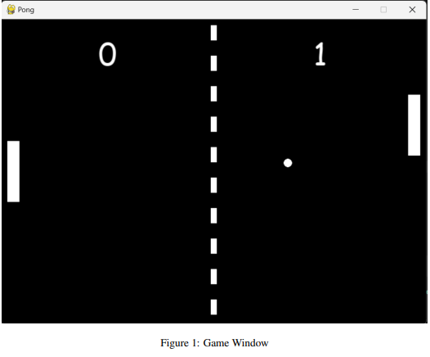
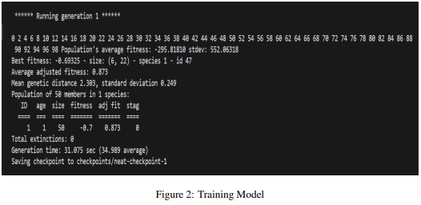
Project screenshots

Slide 11
Future Directions
Prospective developments include the introduction of multiplayer capabilities, the refinement of AI learning algorithms, and the incorporation of intricate game elements to further enhance the gaming experience.

Slide 12
References
A comprehensive list of references is included, citing the sources of information, libraries, and tools used throughout the project’s development.
• Python Documentation:
-https://docs.python.org/3/
• Pygame Documentation:
-https://www.pygame.org/docs/
• NEAT-Python Documentation:
-https://neatpython.readthedocs.io/en/latest/index.html#
• Efficient Evolution of Neural Network Topologies:
-https://nn.cs.utexas.edu/downloads/papers/ stanley.cec02.pdf
• Pong Game Documentation:
-https://pysdl2.readthedocs.io/en/latest/tutorial/pong.html#
• Visual Studio Code Documentation:
-https://code.visualstudio.com/docs

Slide 13
THANK YOU

